Slide 1
How to change the LOGO
on PecStarWeb V3.6
June, 2014

Slide 2

Customize LOGO
Step 1. Collect the customer’s LOGO image in the .png format. For Example: logo_mediacorp.png
The original dimensions of the source image is 253 x 68 pixels

Slide 3

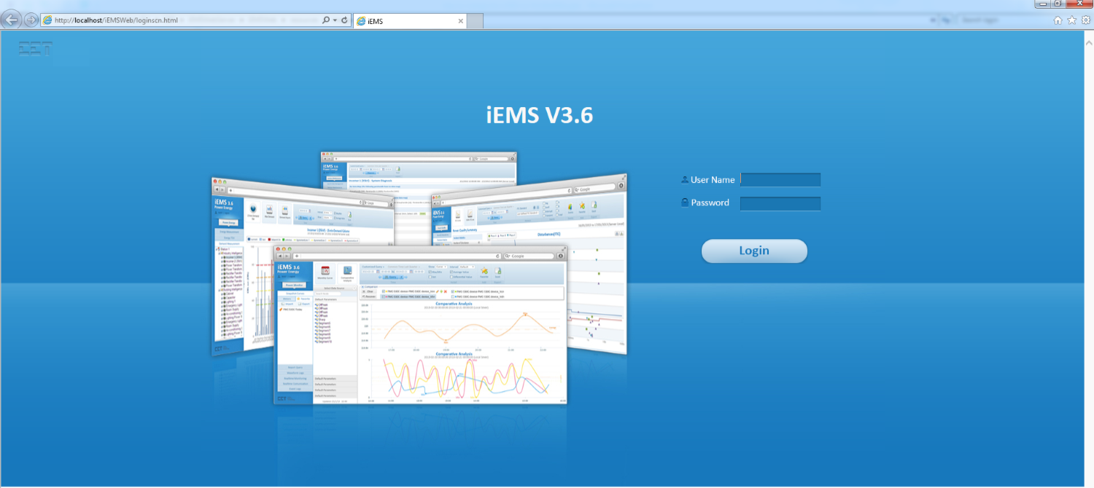
Customize LOGO
Step 2. Modify the customer image to create logo.png and cd-cetlogo-cet.png.
There are two images used for displaying the LOGO on the PecStarWeb:
D:\CET\iEMSWebServer\iEMSWeb\resources\images\login\logo.png
(the directory in red depends on your installation path)
Dimensions: 135 x 43 pixels
Modify the customer image to the same dimensions 135 x 43 pixels as the image and store it to logo.png.

Slide 4
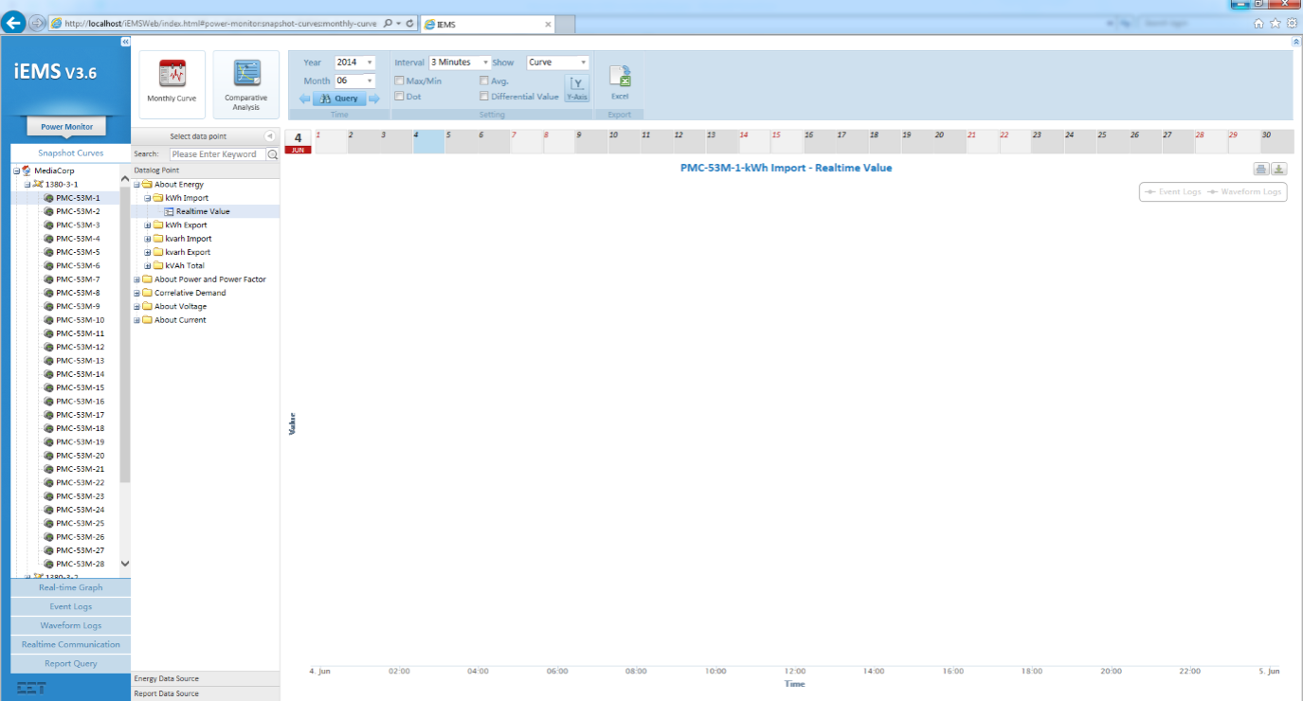
Customize LOGO
2) D:\CET\iEMSWebServer\iEMSWeb\resources\images\frame\cd-cetlogo.png
(the directory in red depends on your installation path)
Dimensions: 90 x 23 pixels
Modify the customer image to the same dimensions 90 x 23 pixels as the image and store it to cd-cetlogo.png.

Slide 5
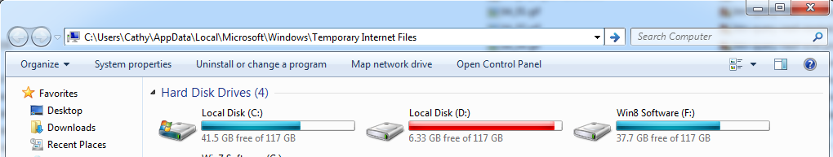
Customize LOGO
Step 3. Navigate to the folders and replace the two images with the modified images.
Step 4. Open Computer and enter the location in the address bar and then press Enter: C:\Users\Administrator\AppData\Local\Microsoft\Windows\Temporary Internet Files
(change the name in red to current login user as needed)

Slide 6
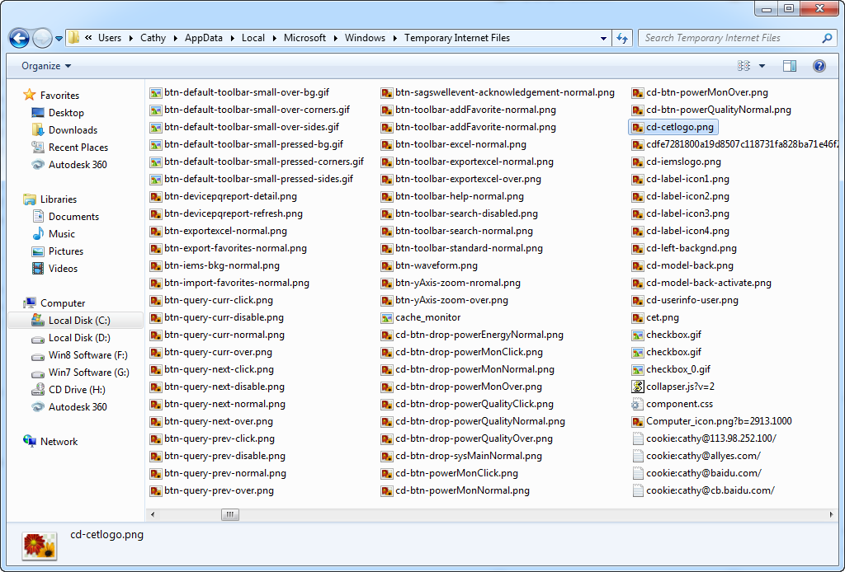
Customize LOGO
Step 5. Delete the logo.png and cd-cetlogo-cet.png under the location.

Slide 7
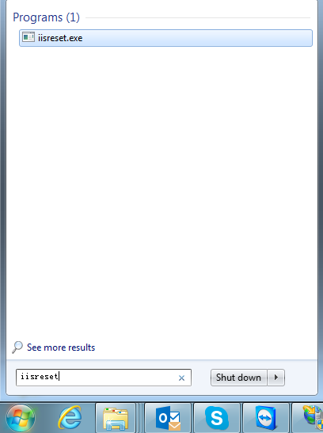
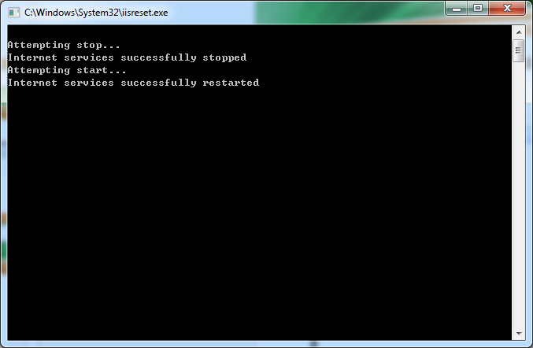
Customize LOGO
Step 6. Input iisreset from Windows → Run, the iisreset.exe is found, then right-click on it and select Run as administrator.
The iisreset command is successfully performed:

Slide 8
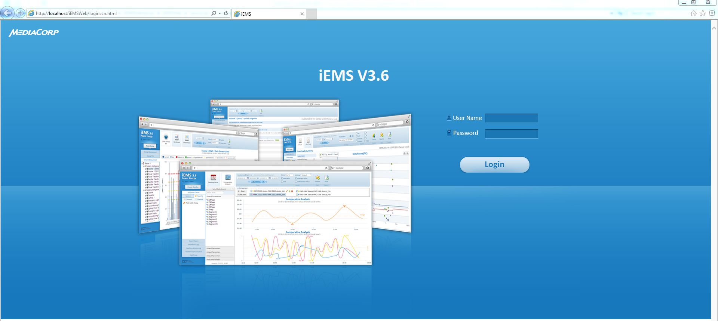
Customize LOGO
Step 7. Restart IE, and the Login page is shown as below:
The LOGO has been changed successfully.

Slide 9
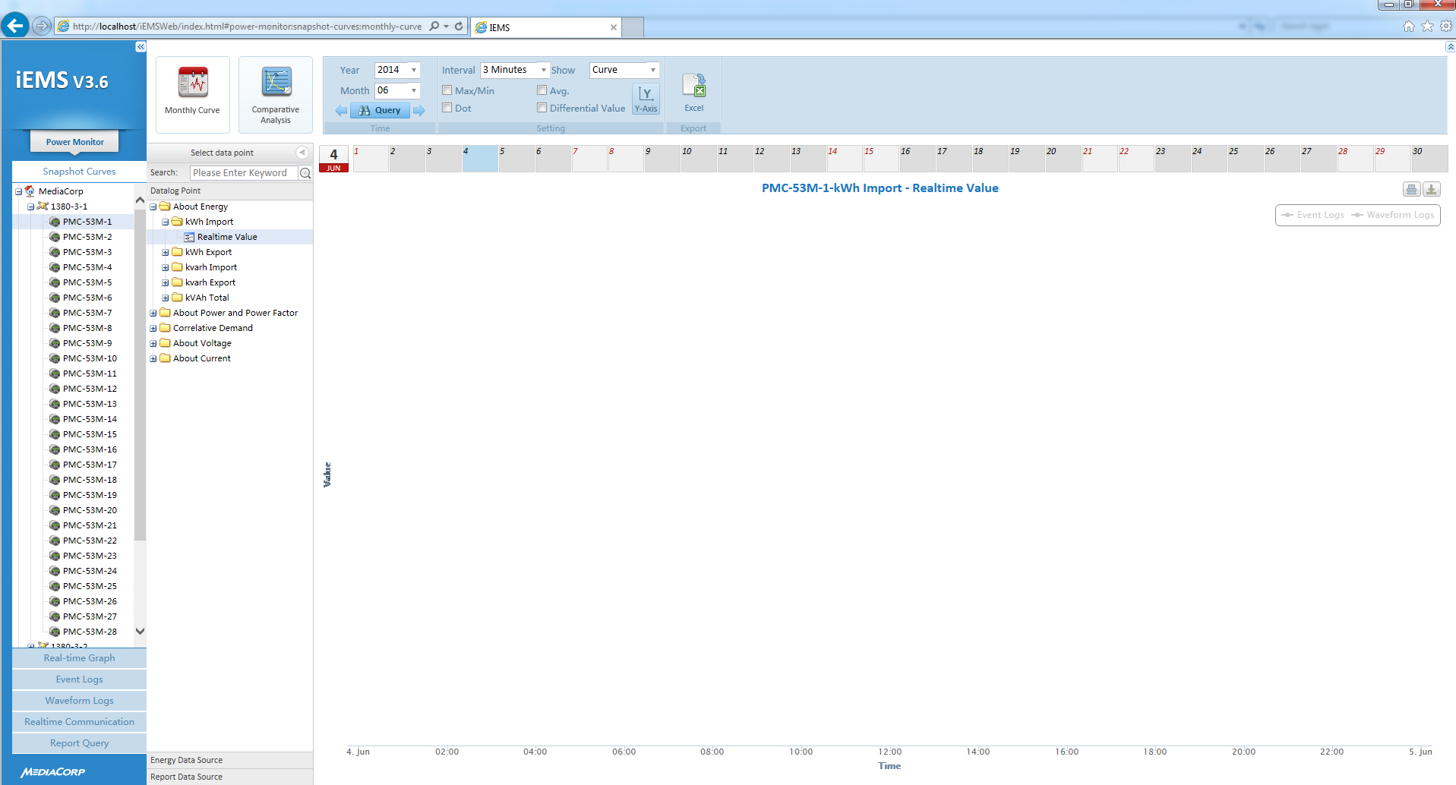
Customize LOGO
The Main page is shown as below:
The LOGO has been changed successfully.

Slide 10
Thank You

